Slide 1

Chapter 9 Function II

Slide 2
Objective
What is Function?
Types of Function.
Structure of Function.
Pass and Return Function statement.
Scope and Lifetime of variable.
Pass by value and Pass by reference.

Slide 3
Variable and scope of Function
Global variable are declared outside of all functions are known as external variables. External or global variables are accessible to any function.
Local variable The variables declared inside the function are automatic or local variables. The local variables exist only inside the function in which it is declared. When the function exits, the local variables are destroyed.

Slide 4
Example
#include<stdio.h>
int num1; // num1 is global variable
void test(void); /*Function Prototype*/
int main()
{
num1 = 19; // no num1 declaration
printf ("line1 (main) : num1 = %d\n",num1);
test();
printf ("line2 (main) : num1 = %d\n",num1);
return 0;
}
void test()
{
num1 = 26; // no num1 declaration
printf ("line1 (test) : num1 = %d\n",num1);
}
line1 (main) : num1 = 19
line1 (test) : num1 = 26
line2 (main) : num1 = 26

Slide 5
Example
#include<stdio.h>
void test(void); /*Function Prototype*/
int main()
{
int num1; // local num1 in main()
num1 = 19;
printf ("line1 (main) : num1 = %d\n",num1);
test();
printf ("line2 (main) : num1 = %d\n",num1);
return 0;
}
void test()
{
int num1; // local num1 in test()
num1 = 26;
printf ("line1 (test) : num1 = %d\n",num1);
}
line1 (main) : num1 = 19
line1 (test) : num1 = 26
line2 (main) : num1 = 19

Slide 6
Example : Please show output of this program
#include<stdio.h>
void test(void); /*Function Prototype*/
int num1; //global num1
int main()
{
int num1; // local num1 in main()
num1 = 19;
printf ("line1 (main) : num1 = %d\n",num1);
test();
printf ("line2 (main) : num1 = %d\n",num1);
return 0;
}
void test()
{
num1 = 26;
printf ("line1 (test) : num1 = %d\n",num1);
}

Slide 7
Objective
What is Function?
Types of Function.
Structure of Function.
Pass and Return Function statement.
Scope and Lifetime of variable.
Pass by value and Pass by reference.

Slide 8
Pass by value Function
void func(int va)
{
va = va+1;
printf ("In function la = %d\n",va);
}

Slide 9
Pass by reference Function
void func2(int *pa)
{
*pa = *pa +1;
printf ("In function *pa = %d\n",*pa);
}

Slide 10
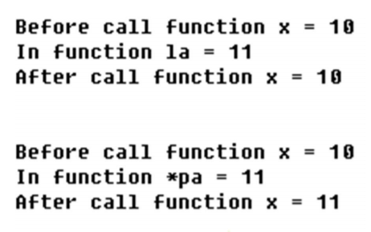
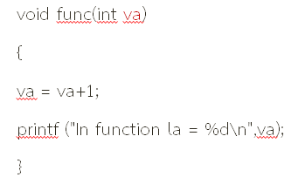
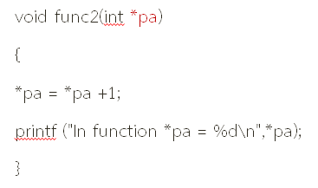
Main Function
int main()
{
int x;
x = 10;
printf ("Before call function x = %d\n",x);
func(x);
printf ("After call function x = %d\n",x);
printf ("\n\n");
x = 10;
printf ("Before call function x = %d\n",x);
func2(&x);
printf ("After call function x = %d\n",x);
return 0;
}

Slide 11
Example : Function and Array
#include <stdio.h>
int findmax( int * );
int main()
{
int i, a[10];
printf ("Input 10 number ");
for ( i=0; i<10; i++ )
scanf ( "%d", &a[i] );
printf ( “ \nmax number = %d “ ,
findmax( a ) );
return 0;
}
int findmax( int *p )
{ int i, temp;
for (i=0;i<9;i++) {
if ( *(p+1) < *p ) {
temp = *p;
*p = *(p+1) ;
*(p+1) = temp;
}
p++ ;
}
return *p;
}

Slide 12
Q&A
#include <stdio.h>
#include <conio.h>
int a;
void func(int x)
{
x=10;
printf("x = %d\n",x);
}
int main()
{
int b;
a = 3;
b = 5;
func(b);
printf ("a = %d\n",a);
printf ("b = %d\n",b);
return 0;
}
OUTPUT
x = 10
a = 3
b = 5

Slide 13
Q&A
#include <stdio.h>
#include <conio.h>
int a;
void func(int *x)
{
*x=10;
printf("x = %d\n",*x);
}
int main()
{
int b;
a = 3;
b = 5;
func(&b);
printf ("a = %d\n",a);
printf ("b = %d\n",b);
return 0;
}
OUTPUT
x = 10
a = 3
b = 10

Slide 14
Q&A
#include <stdio.h>
#include <conio.h>
int a;
void func(int x)
{
a=10;
printf("x = %d\n",x);
}
int main()
{
int b;
a = 3;
b = 5;
func(b);
printf ("a = %d\n",a);
printf ("b = %d\n",b);
return 0;
}
OUTPUT
x = 5
a = 10
b = 5

Slide 15
Exercise
1. This is the program to collect the data of object 1 type. The program consists of functions below. getdata() function to get the data of object.
add10() function to increase the data of object 10 pieces.
sub10() function to decrease the data of object 10 pieces.
and function to show the detail of each object.
(This program still can't run, Please complete the program below)

Slide 16
Exercise
#include <stdio.h>
#include <string.h>
struct product {
char name[15];
int number;
float price;
};
struct product getdata(void) {
struct product x;
strcpy(x.name,"Chewing gum");
x.number = 100;
x.price = 25.5;
return x;
}
……… showdata(………………)
{
……………………………………..
}
void sub10(struct product &x) {
if (x.number > 10)
x.number -=10;
}
…………add10(………………..)
{
x.number +=10;
}
int main(void)
{
int i;
struct product y;
y = getdata();
showdata(y);
add10(y);
add10(y);
showdata(y);
sub10(y);
showdata(y);
return 0;
}

Slide 17
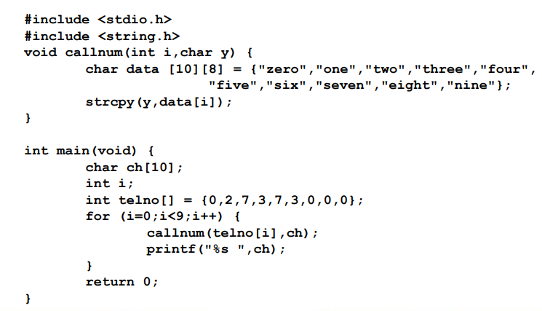
Exercise
2. Explain how does this program work as well as find the wrong point of this program. (Hint: error only 1 point)

Slide 18
Exercise
3.What is the result of this program?
#include <stdio.h>
int i;
struct data {
int i;
int j;
}W;
void fa(int *a, int b);
void fb(int c, int *d);
void fc(struct data x,struct data
*y, struct data z);
int main(void) {
int j=0;
int i = 15;
struct data X,Y,Z;
X.i = 10;
X.j = 20;
fa(&i,j);
printf("\n i=%d, j=%d",i,j);
fb(i,&j);
printf("\n i=%d, j=%d",i,j);
fc(X,&Y,Z);
printf("\n W.i=%d,W.j=%d",W.i,W.j);
printf("\n X.i=%d, X.j=%d",X.i,X.j);
printf("\n Y.i=%d, Y.j=%d",Y.i,Y.j);
printf("\n Z.i=%d, Z.j=%d",Z.i,Z.j);
return 0;
}
void fa(int *a, int b) {
i = 4;
*a = *a+3;
b = i+2;
}

Slide 19
Exercise
void fb(int c,int *d) {
c += i;
*d += i;
}
void fc(struct data x,struct data *y, struct data z) {
y->i = x.j++;
y->j = y->i + (++x.i);
z.i = x.j;
z.j = y->j;
W.i = y->i + (++x.j);
W.j = y->j + z.i;
}

